Slide 1
































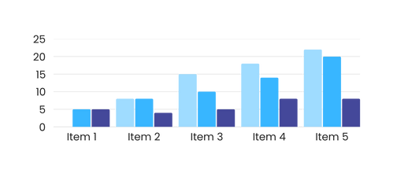



Ingoude Company
Dashboard
Search Here
Claudia Alves
Administrator
$ 2.000,-
My Saved Chart
Advanced Statistic
Balance
Appointment / Contact
Task A
1 Month Ago, 1 Region, 1 Company
40%
+ $ 200.00
On Progress
Dashboard
Call Attempt / Rep
Task B
Insight
1 Month Ago, 1 Region, 1 Company
70%
+ $ 200.00
On Progress
Transaction
Allowed Call / Attempt
1 Month Ago, 1 Region, 1 Company
90%
Account
By Country
Settings
Bar Chart
Add Account
Switch Account
50% in Borcelle
50% in Fauget
Log Out

Slide 2






Ingoude Company
Dashboard
Search Here
Claudia Alves
Administrator
$ 2.000,-
My Saved Chart
Advanced Statistic
Balance
Trips Made
Task A
1 Month Ago, 1 Region, 1 Company
40%
+ $ 200.00
On Progress
Dashboard
Hours Operated
Task B
Insight
1 Month Ago, 1 Region, 1 Company
70%
+ $ 200.00
On Progress
Transaction
Operators
1 Month Ago, 1 Region, 1 Company
90%
Account
Days Worked
Settings
1 Month Ago, 1 Region, 1 Company
90%
Add Account
Switch Account
Log Out

